Slide 1
Prediction Machines Workshop
10/10/22

Slide 2
Agenda
Welcome
Data
Models
Implementation
Q & A

Slide 3
Welcome
Welcome to this workshop!
No big code files – all done in less than 100 lines
No big theory part
→ Follow instructions and learn!

Slide 4
Data
Old Dataset: Collected in 1988
Heart failure prediction based off of madical data
303 Datapoints with 13 explanatory variables and 1 outcome
Goal: Find a model to predict patients who are in danger of heart failure
https://archive.ics.uci.edu/ml/datasets/heart+Disease

Slide 5
Data
Data preperation
Clean the data
2. Split the data into Training and Testing
→ Why?

Slide 6
Models
Logistic models
K-Nearest Neighbours
Random Forrest
Support Vector Machines

Slide 7
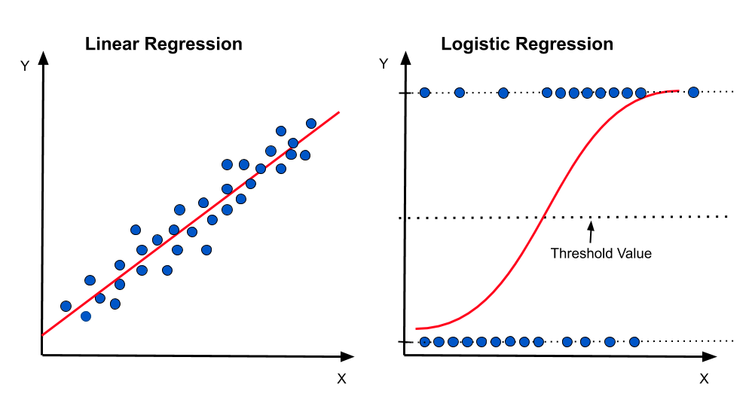
Models: Logistic regression
Model based off an S-curved
Prediction line
The model swaps the
predictions based off a threshold
value

Slide 8
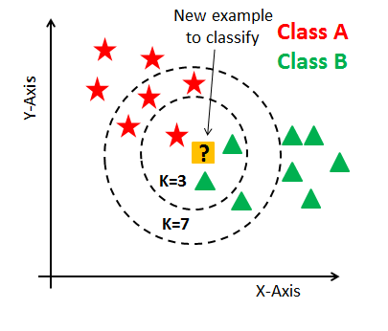
Models: K-Nearest Neighbours
K-Nearest Neighbours, where
«K» stands for a number
Calculate the mathematical
distance to the known data points,
then assign the new data point to
the closest class

Slide 9
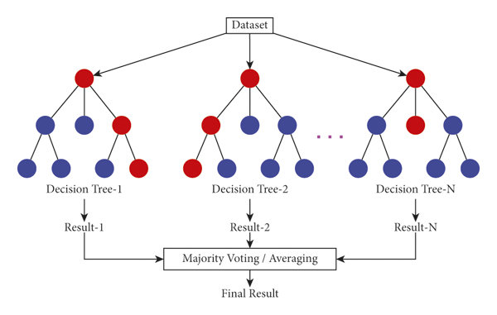
Models: Random Forrest
Build different decision trees
Let the trees vote, then take
the majority of the votes as the
prediction

Slide 10
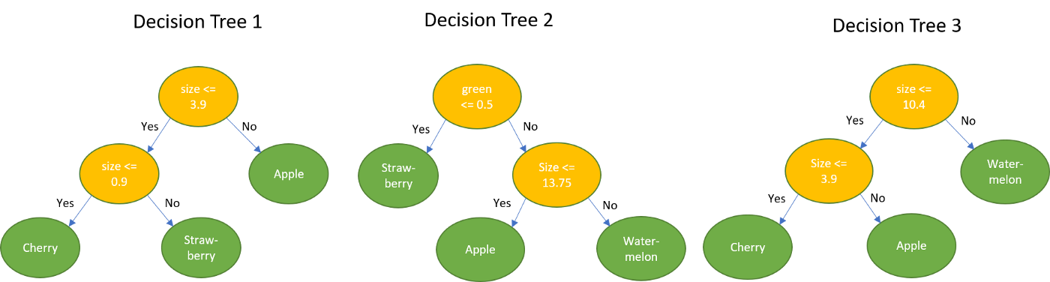
Models: Random Forrest
Decision trees:

Slide 11
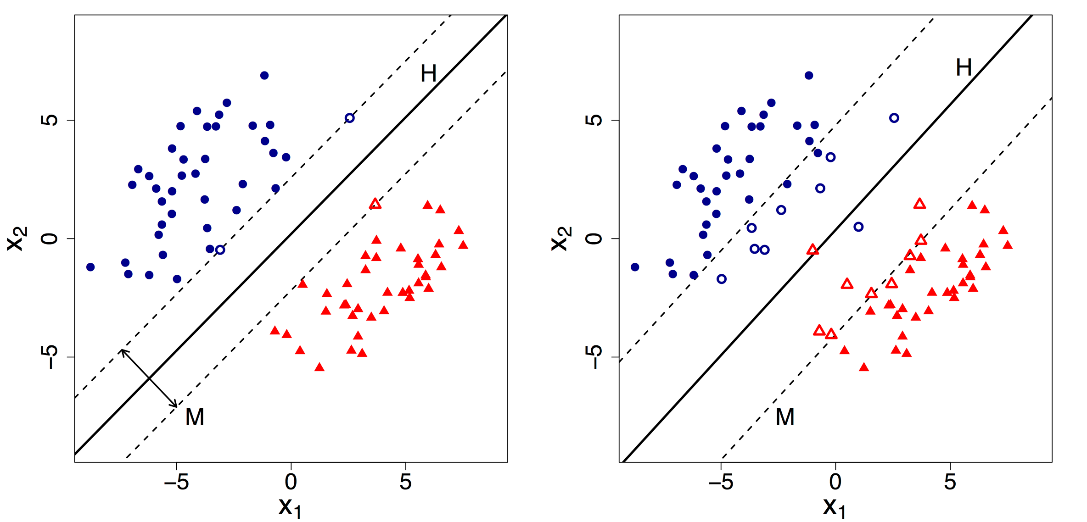
Models: Support Vector Machines
Find the closest points,
build support vectors and
then build a seperator
This does not have to be
linear

Slide 12
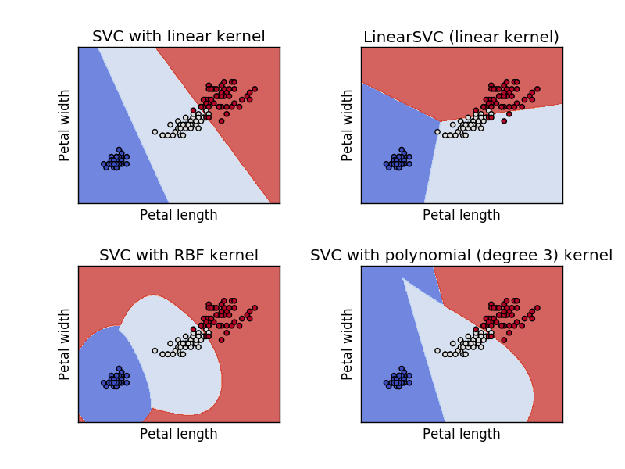
Models: Support Vector Machines
Find the closest points,
build support vectors and
then build a seperator
This does not have to be
linear

Slide 13
Implementation
Alright, let’s try this in Python then!
Link to the repository:
https://tinyurl.com/yc2p24ny

